Slide 1
Threads Introduction

Slide 2
Thread: Introduction
Each process has
  Own Address Space
  Single thread of control
A process model has two concepts:
  Resource grouping
  Execution
Sometimes it is useful to separate them
Operating Systems -

Slide 3
Unit of Resource Ownership
A process has an
  Address space
  Open files
  Child processes
  Accounting information
  Signal handlers
If these are put together in a form of a process, can be managed more easily
Operating Systems -

Slide 4
Unit of Dispatching
Path of execution
  Program counter: which instruction is running
  Registers:
    holds current working variables
  Stack:
    Contains the execution history, with one entry for each procedure called but not yet returned
  State
Processes are used to group resources together
Threads are the entities scheduled for execution on the CPU
Threads are also called lightweight process
Operating Systems -

Slide 5
Its better to distinguish between the two concepts
  Address space/Global Variables
  Open files
  Child processes
  Accounting info
  Signal handlers
  Program counter
  Registers
  Stack
  State
Heavy weight process
In case of multiple threads per process
Unit of Resource
Split
Unit of Dispatch
  Address space/Global Variables
  Open files
  Child processes
  Accounting Info
  Signal Handlers
  Program Counter
  Registers
  Stack
  State
Light weight processes
  Program Counter
  Registers
  Stack
  State
  Program Counter
  Registers
  Stack
  State
Share
Operating Systems -

Slide 6
Threads
Allow multiple execution paths in the same process environment
Threads share address space, open files etc
But have own set of Program counter, Stack etc
The first thread starts execution with
  int main(int argc, char *argv[])
The threads appear to the Scheduling part of an OS just like any other process
Operating Systems -

Slide 7

Process Vs. Threads
(a) Three threads, each running in a separate address space
(b) Three threads, sharing the same address space
Operating Systems -

Slide 8

The Thread Model
Each thread has its own stack
Operating Systems -

Slide 9
Thread Usage
Less time to create a new thread than a process
    the newly created thread uses the current process address space
    no resources attached to them
Less time to terminate a thread than a process.
Less time to switch between two threads within the same process, because the newly created thread uses the current process address space.
Less communication overheads
    threads share everything: address space, in particular. So, data produced by one thread is immediately available to all the other threads
Performance gain
    Substantial Computing and Substantial Input/Output
Useful on systems with multiple processors
Operating Systems -

Slide 10
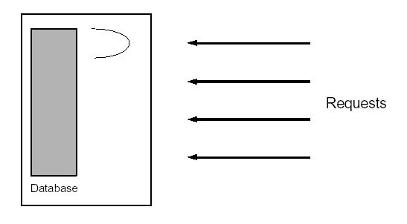
1. Single threaded database server
Handles multiple clients
  Either handle the requests sequentially
  Or multiplex explicitly by creating multiple processes
Problems
  Unfair for quick requests, occurring behind lengthy request
  Complex and error prone
  Heavy IPC required
Operating Systems -

Slide 11
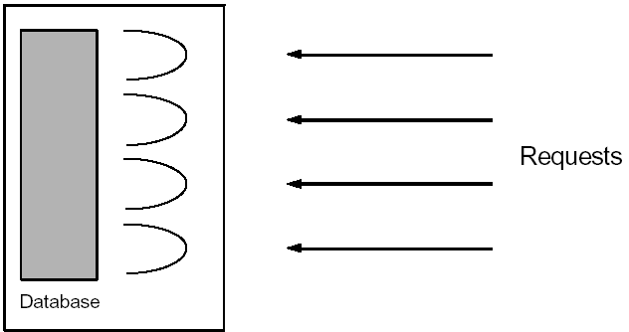
1. Multithreaded database server
Assign a separate thread to each request
As fair as in the multiplexed approach.
The code is as simple as in the sequential approach, since the address space is shared - all variables are available
Some synchronization of access to the database is required, this is not terribly complicated.
Operating Systems -

Slide 12

e.g. A multithreaded web server
Operating Systems -

Slide 13

2. Background Processing
Consider writing a GUI-based application that uses:
  Mouse
  Keyboard input
  Handles various clock-based events
In a single threaded application, if the application is busy with one activity, it cannot respond (quickly enough) to other events, such as mouse or keyboard input.
Handling such concurrency is difficult and complex
But simple in a multithreaded process
Operating Systems -

Slide 14

e.g. A word processor with 3 threads
Operating Systems -

Slide 15
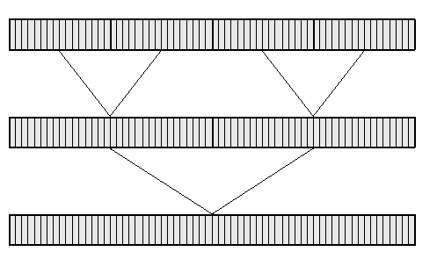
3. Parallel Algorithms e.g. Merge Sort
Sort some data items on a shared-memory parallel computer.
Our task is merely to implement a multithreaded sorting algorithm.
  Divide the data into four pieces
  Have each processor sort a different piece.
  Two processors each merge two pieces
  One processor merges the final two combined pieces.
Operating Systems -

Slide 16
Thread state
Each thread has its own stack and local variables
Globals are shared.
File descriptors are shared. If one thread closes a file, all other threads can’t use
The file I/O operations block the calling thread.
Some other functions act on the whole process.
  For example, the exit() function operates terminates the entire and all associated threads.
Feb 23, 2009
Operating Systems - Mehreen Alam

Slide 17
Thread Implementation
The most important of these APIs, in the Unix world, is the one developed by the group known as POSIX.
POSIX is a standard API supported
Portable across most UNIX platforms.
PTHREAD library contains implementation of POSIX standard
To link this library to your program use –lpthread
  gcc MyThreads.c -o MyThreadExecutable - lpthread
Feb 23, 2009
Operating Systems - Mehreen Alam

Slide 18
Thread Creation
pthread_create( pthread_t *threadid
,const pthread_attr_t *attr, void
*(*start_routine)(void *),void *arg);
  This routine creates a new thread and makes it executable.
  Thread stack is allocated and thread control block is created
  Once created, a thread may create other threads.
  Note that an "initial thread" exists by default and is the thread which runs main.
  Returns zero, if ok
  Returns Non-zero if error
  threadid
    The routine returns the new thread ID via the threadid
    The caller can use this thread ID to perform various operations
    This ID should be checked to ensure that the thread was successfully created.
Feb 23, 2009
Operating Systems - Mehreen Alam

Slide 19
Thread Creation
pthread_create( pthread_t *threadid
,const pthread_attr_t *attr, void
*(*start_routine)(void *),void *arg);
attr
  used to set thread attributes.
  NULL for the default values.
start_routine
  The C routine that the thread will execute once it is created.
arg
  Arguments are passed to start_routine via arg.
  Arguments must be passed by reference as pointers
  These pointers must be cast as pointers of type void.
Feb 23, 2009
Operating Systems - Mehreen Alam

Slide 20
Attribute Object
When an attribute object is not specified, it is NULL, and the default thread is created with the following attributes:
  It is non-detached
  It has a a default stack and stack size
  It inherits the parent's priority
Feb 23, 2009
Operating Systems - Mehreen Alam

Slide 21
Thread Termination
pthread_exit(status)
Several ways of termination:
  The thread returns from its starting routine (the main routine for the initial thread).
  The thread makes a call to the pthread_exit subroutine.
  The thread is canceled by another thread via the pthread_cancel routine.
  The entire process is terminated due to a call to the exit subroutines.
Feb 23, 2009
Operating Systems - Mehreen Alam

Slide 22
Thread Termination
The pthread_exit() routine does not close files; any files opened inside the thread will remain open after the thread is terminated.
If the "initial thread" exits with pthread_exit() instead of exit(), other threads will continue to execute.
The programmer may specify a termination status, which is stored as a void pointer for any thread that may join the calling thread i.e wait for this thread.
Feb 23, 2009
Operating Systems - Mehreen Alam

Slide 23
#include <pthread.h>
#include <stdio.h>
#define NUM_THREADS 5
void * PrintHello(void *threadid)
{ printf("\n%d: Hello World!\n", threadid);
pthread_exit(NULL);
}
int main()
{
pthread_t threads[NUM_THREADS];
int rc, t;
for(t=0;t < NUM_THREADS;t++)
{
printf("Creating thread %d\n", t);
rc = pthread_create(&threads[t], NULL, PrintHello, (void *)&t);
if (rc)
{
printf("ERROR; return code from pthread_create() is %d\n", rc);
exit(-1);
}
}
pthread_exit(NULL); }
Feb 23, 2009
Operating Systems - Mehreen Alam

Slide 24
Passing Arguments To Threads
The pthread_create() routine permits the programmer to pass one argument to the thread start routine.
What if we want to pass multiple arguments.
Create a structure which contains all of the arguments
Pass a pointer to the structure in the pthread_create() routine.
Argument must be passed by reference and cast to (void *).
Important:
  Threads initially access their data structures in the parent thread's memory space.
  That data structure must not be corrupted/modified until the thread has finished accessing it.
Feb 23, 2009
Operating Systems - Mehreen Alam

Slide 25
Incorrect pthread_create() argument passing
for(t=0;t < NUM_THREADS;t++)
{
printf("Creating thread %d\n", t);
rc = pthread_create(&threads[t],
NULL, printHello, (void *) &t);
...
}
Feb 23, 2009
Operating Systems - Mehreen Alam

Slide 26
Correct pthread_create() argument passing
int *task_ids[NUM_THREADS];
for(t=0;t < NUM_THREADS;t++)
{
task_ids[t] = new int;
*task_ids[t] = t;
printf("Creating thread %d\n", t);
rc = pthread_create(&threads[t], NULL, PrintHello, (void *) task_ids[t]);
...
}
Feb 23, 2009
Operating Systems - Mehreen Alam

Slide 27
Passing a structure as an argument
struct thread_data
{ int thread_id;
int sum;
};
thread_data thread_data_array[NUM_THREADS];
void *PrintHello(void *threadarg)
{ thread_data *my_data;
...
my_data = (struct thread_data *) threadarg; taskid = my_data->thread_id;
sum = my_data->sum;
...
}
Feb 23, 2009
Operating Systems - Mehreen Alam

Slide 28
Passing a structure as an argument
int main()
{ ...
thread_data_array[t].thread_id = t;
thread_data_array[t].sum = sum;
rc = pthread_create(&threads[t], NULL,
PrintHello, (void )&thread_data_array[t]) ;
...
}
Feb 23, 2009
Operating Systems - Mehreen Alam

Slide 29
Thread ID
pthread_self()
  Returns the unique thread ID of the calling thread.
pthread_equal(threadid1,threadid2)
  Compares two thread IDs:
    If the two IDs are different 0 is returned, otherwise a non-zero value is returned.
Feb 23, 2009
Operating Systems - Mehreen Alam

Slide 30
Thread Suspension and Termination
Similar to UNIX processes, threads have the equivalent of the wait() and exit() system calls
pthread_join()
  Used to block threads
pthread_exit()
  Used to terminate threads
To instruct a thread to block and wait for a thread to complete, use the pthread_join() function.
This is also the mechanism used to get a return value from a thread
Any thread can call join on (and hence wait for) any other thread.
Feb 23, 2009
Operating Systems - Mehreen Alam

Slide 31
Detached State
Each thread can be either joinable or detached.
Detached: on termination all thread resources are released by the OS.
A detached thread cannot be joined.
No way to get at the return value of the thread.
Feb 23, 2009
Operating Systems - Mehreen Alam

Slide 32
Joining thread
Joinable: on thread termination the thread ID and exit status are saved by the OS.
Joining a thread means waiting for a thread
pthread_join(threadid, status)
  "Joining" is one way to accomplish synchronization between threads.
  subroutine blocks the calling thread until the specified threadid thread terminates.
    The programmer is able to obtain the target thread's termination return status (if specified) in the status parameter.
It is impossible to join a detached thread
Feb 23, 2009
Operating Systems - Mehreen Alam

Slide 33
Joining thread
Multiple threads cannot wait for the same thread to terminate.
If they try to, one thread returns successfully
The others fail with an error of ESRCH
After pthread_join() returns, any stack storage associated with the thread can be reclaimed by the application.
Threads which have exited but have not been joined are equivalent to zombie processes.
Their resources cannot be fully recovered.
Feb 23, 2009
Operating Systems - Mehreen Alam

Slide 34
pthread_detach()
By default threads are created joinable.
Instead of waiting for a child, a parent thread can specify that
  it does not require a return value
  or any explicit synchronization with that thread.
To do this, the parent thread uses the pthread_detach() function.
After this call, there is no thread waiting for the child – it executes independently until termination.
To avoid memory leaks a thread should
  either be joined
  Or detached by a call to pthread_detach()
int pthread_detach(pthread_t tid);
  Returns 0 on OK, nonzero on error
Threads can detach themselves by calling pthread_detach with an argument of pthread_self
Feb 23, 2009
Operating Systems - Mehreen Alam

